Slide 1
Good morning !
Good morning !
Good morning !
Good morning to you!
Good morning dear N.N.!
I am glad to see you!

Slide 2
Good morning!
Good afternoon!
Good evening!
Good night!
Hello!
Nice to meet you!
Nice to meet you too!
Good bye!
See you!

Slide 3
Какой звук в словах?
hello
Alice
Brill

Slide 4
Какой звук в словах?
my
name
Mick

Slide 5
Какой звук в словах?
Ron
Mary
read
run

Slide 6
Какой звук в словах?
Nora
Denzil
and
name

Slide 7
Read
My name is Nora.
My name is Denzil.
My name is Ron.
My name is Alice.
My name is Brill.
My name is Mary.
My name is Mick.

Slide 8
read
Read Nora!
Read Denzil.
Read Ron.
Read Alice.
Read Brill.
Read Mary.
Read Mick.

Slide 9
run
Run Nora!
Run Denzil.
Run Ron.
Run Alice.
Run Brill.
Run Mary.
Run Mick.

Slide 10
Найди слова с буквой ,, Ll ,, Прочитай.
Hello name glass Denzel
Alice my Brill Ron
Nora run read fly

Slide 11
Найди слова с буквой ,, Mm,, Прочитай.
Hello name glass Denzel
Alice my Brill Ron
Nora run read fly

Slide 12
Найди слова с буквой ,, Nn,, Прочитай.
Hello name glass Denzel
Alice my Brill Ron
Nora run read fly

Slide 13
Найди слова с буквой ,, Rr,, Прочитай.
Hello name glass Denzel
Alice my Brill Ron
Nora run read fly

Slide 14
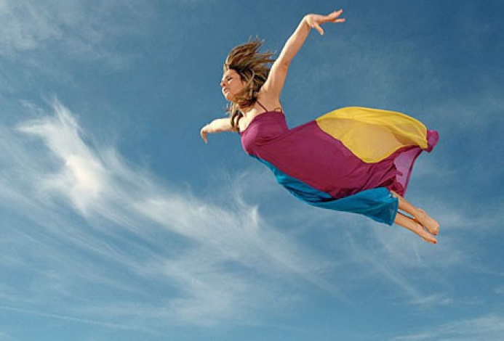
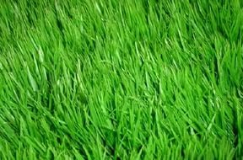
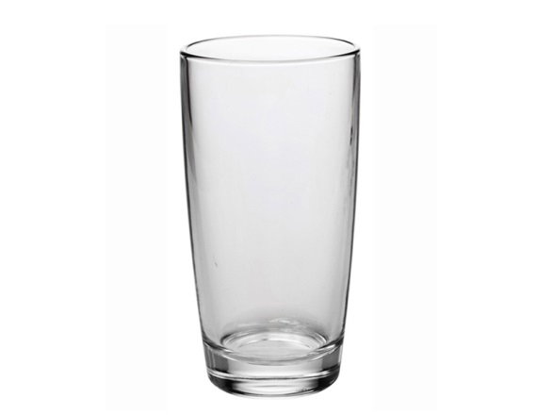
fly
grass
glass
sun

