Slide 1
Fine! sad
OK! happy
Bad! hungry
Supper! thirsty
Very good! angry
Excellent!
Wonderful!

Slide 2
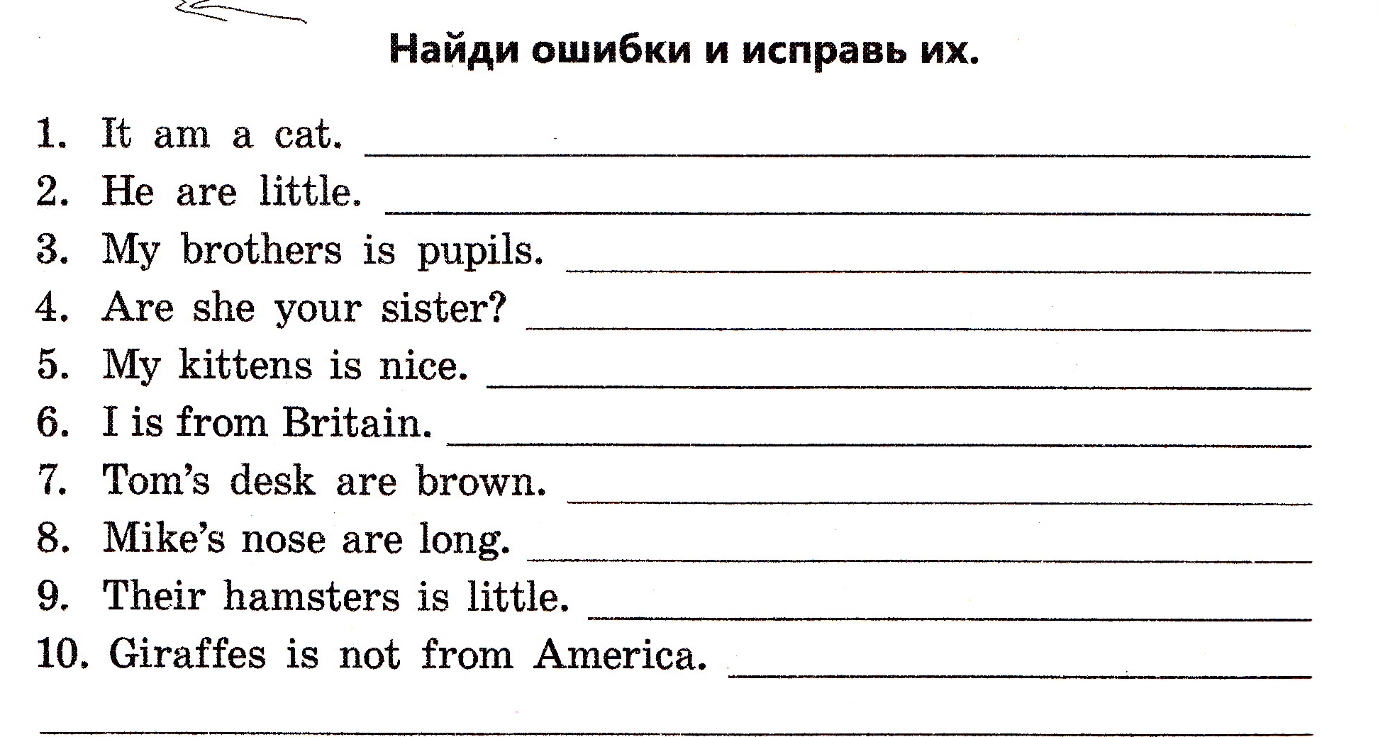

Slide 3
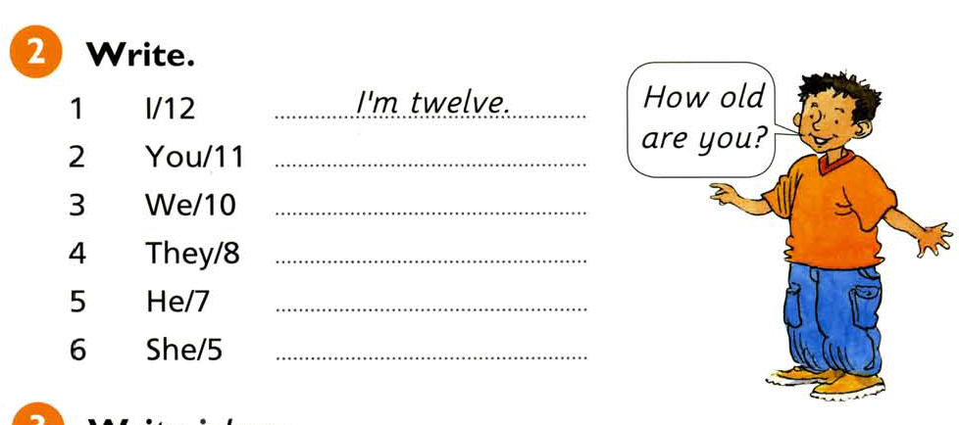

Slide 4
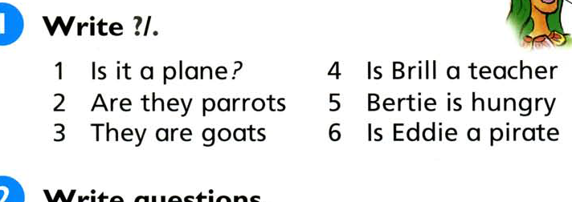

Slide 5
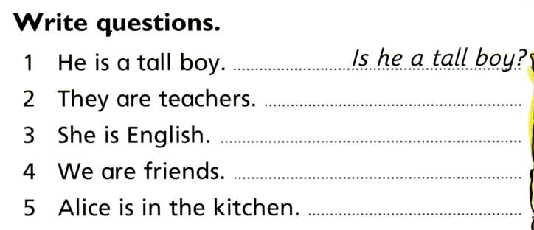

Slide 6
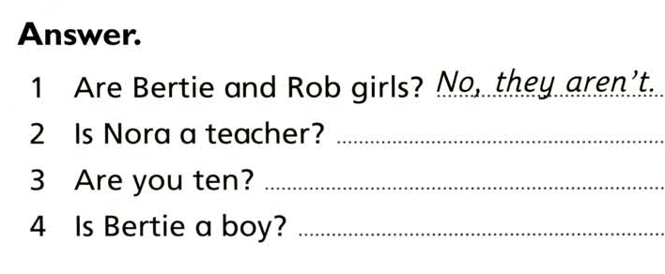

Slide 7
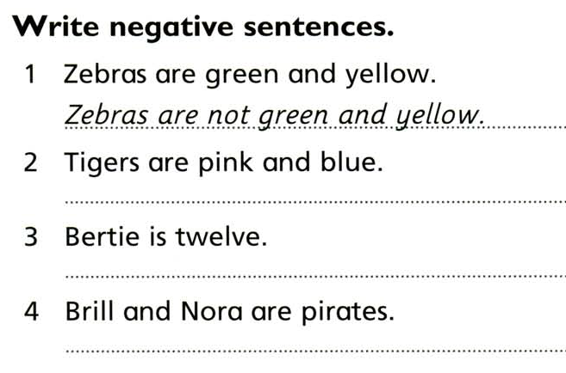

Slide 8
Goodbye!

