Slide 1
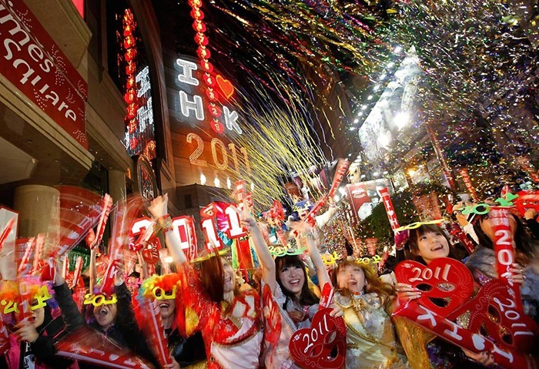
New Year in Japan

Slide 2
New Year in Japan has the status of a public holiday, celebrated annually on January 1 in the Gregorian calendar. The Gregorian calendar was adopted in Japan in 1873, five years after the Meiji Restoration, so that the first day of January - the date of the official New Year in Japan today.
Date of Traditional Japanese New Year was based on the Chinese lunar calendar and was located in the early spring, just as in China and other East Asian countries.

Slide 3
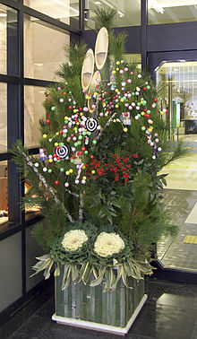
Move holiday
New Year - the most important holiday in the Japanese calendar rites . Since it involves a lot of games , rituals and ceremonies . On New Year's holidays in Japan account for most holidays. Usually holidays stretch from December 29 to January 3 , and virtually all state and commercial institutions in the country do not work [1 ] [2] .
In late December , New Year's Eve , the Japanese clean up in their homes , buy gifts for friends and relatives , send New Year's greeting cards ( Jap.年 贺 状nengadze : ? ) Preparing holiday meals , put up at the entrance to the house of pine decorations kadomatsu ( Jap.门 松?, letters. " pine at the entrance "), which symbolically guard the house from evil forces. In the New Year holidays , many Japanese are sent to their homes , visiting temples, where they pray and ask for prosperity for themselves and their loved ones. Girls and women on the occasion of this event colorful kimono dress .

Slide 4
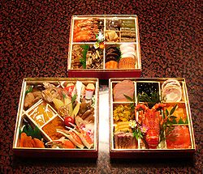
Festive table
Traditional dishes that Japanese eat on New Year's called Awsat - ryori , or just Awsat . Usually consists of boiled seaweed , fish pie , mashed sweet potatoes with chestnuts , boiled burdock root , and sweet black soy. Many of these dishes , sweet , sour , or dried so that they can be stored without refrigeration . There are many different options Awsat , and it happens that the dishes that are used in one region may not be used (or even be banned ) in the other. Today, sashimi and sushi , as well as Japanese food is not often used for a holiday.
Hard to imagine Christmas without a Japanese table - mochi bread loaves or cakes made ​​from sticky rice varieties . Mochi for New Year - this is the wish of prosperity, wealth and good harvest next year. Ancient round mochi associated with round mirrors - essential attributes of the goddess Amaterasu .

Slide 5
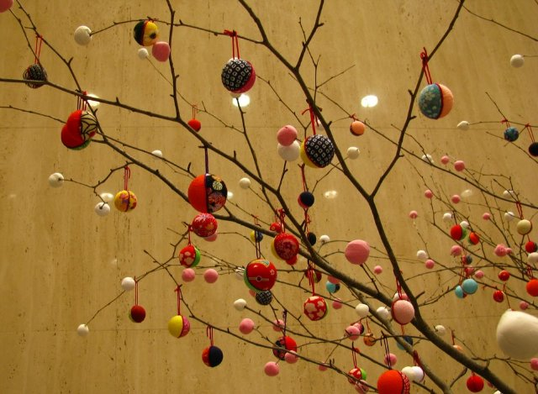
There is a custom of decorating the house with bamboo or willow branches with hanging them mochi in the form of fish, fruits, flowers , and . etc. These ornaments are called motibana , they are painted in different colors and are set in a conspicuous place or suspended from the ceiling at the entrance. This is done in order to ' input' into the house deity New Year - tosigami , recalled his "duty" to take care of the hosts in the new year . After the holidays motibana eaten , and by tradition , each family member should eat as much as he was years in the gode .

Slide 6
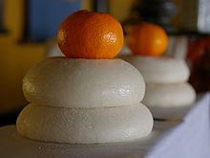
Another type of holiday are kagami mochi mochi Yap letters. "Mirror rice cake ") - in plain sight are two mochi interconnected and attached orange top Japanese

Slide 7
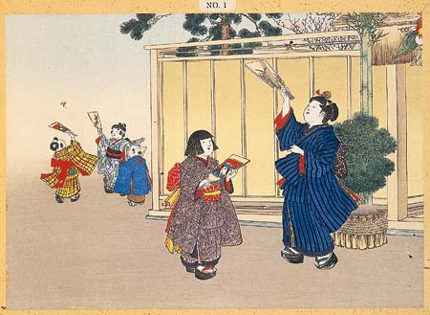
Games, rituals, ceremonies
On New Year's made ​​to play the traditional New Year games. For example hanetsuki - playing shuttlecock.

Slide 8
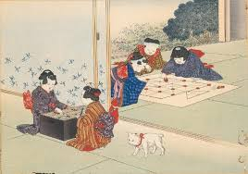
Sugoroku - a game similar to backgammon,

Slide 9
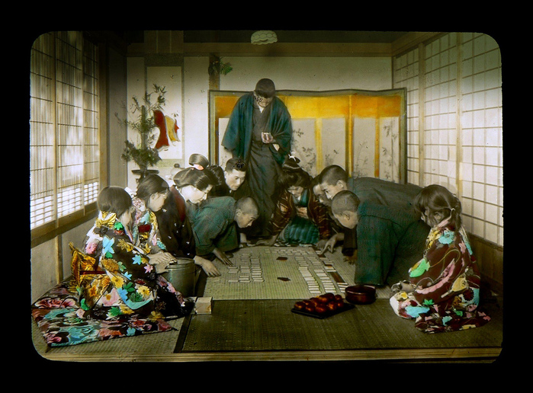
Utagaruta - Christmas cards with verses hyakunin issyu.

Slide 10
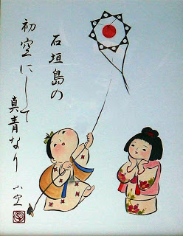
Zapuskanie kites and tops.

Slide 11
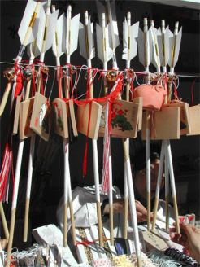
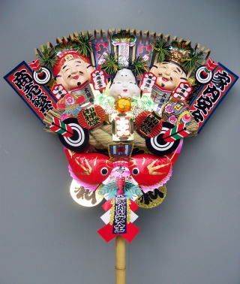
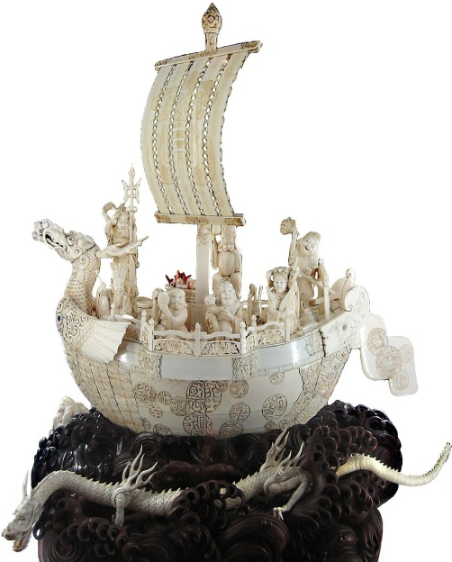
Prihramovye shops sell a variety of New Year charms and souvenirs: Hamah - arrows with white plumage and a blunt tip that protect the house from evil and misfortune; kumade - rake of bamboo, similar to "bear's paw", which according to legend can "rake" happiness; takarabune - Seven Lucky Gods boats stuffed with rice and other treasures.
Hamah
Kumade
Takarabune

Slide 12
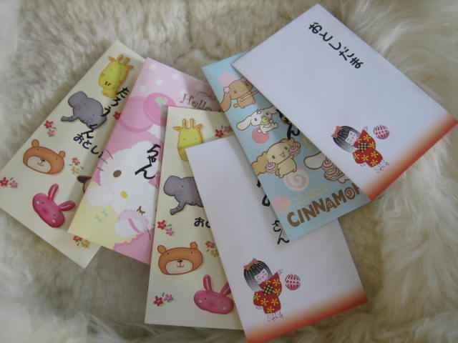
Christmas custom to give children money called otosidama. Money put into small decorated envelopes called potibukuro. The amount of money that is put into the envelope depends on the age of the child, but if the family has several children, the amounts are generally the same, so that no one felt deprived.
Potibukuro

