Slide 1
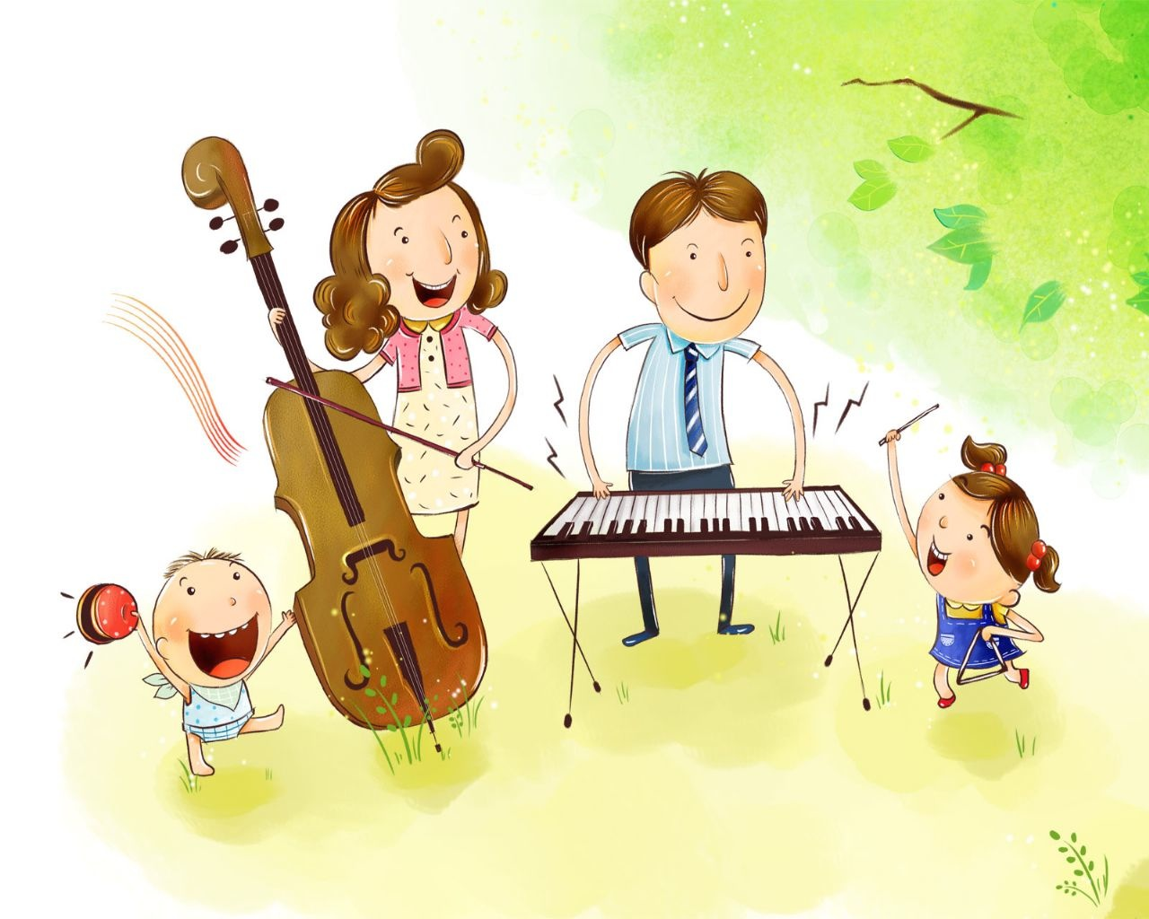
FAMILY

Slide 2
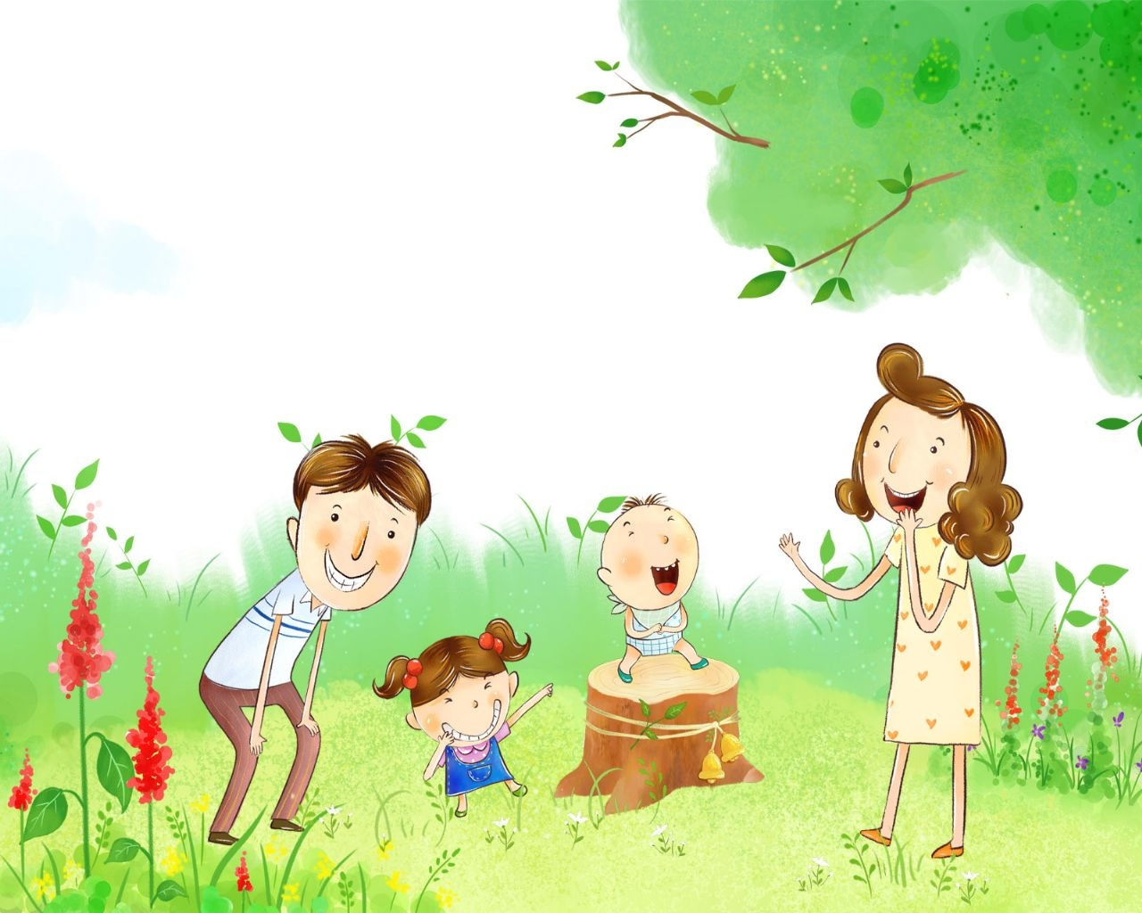
I have a father.
I have a mother.
I have a sister.
I have a brother.
Father, Mother, Sister, Brother -
Hand in hand with one another.

Slide 3
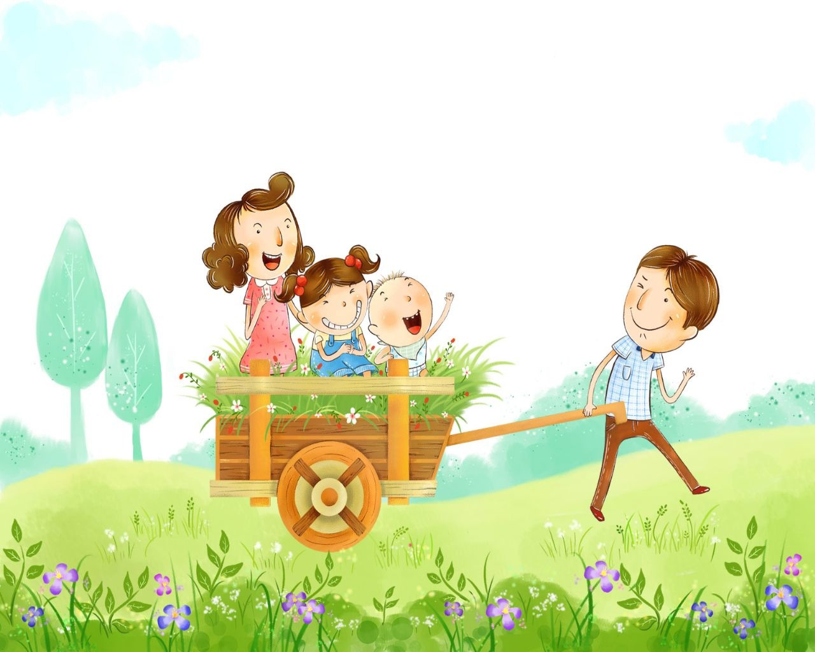
Mother is the dearest of all friends I know.
She helps me with a lot of things,
That’s why I love her so.
Father is the kindest of all friends I know.
He likes to take me out with him,
That’s why I love him so.

Slide 4
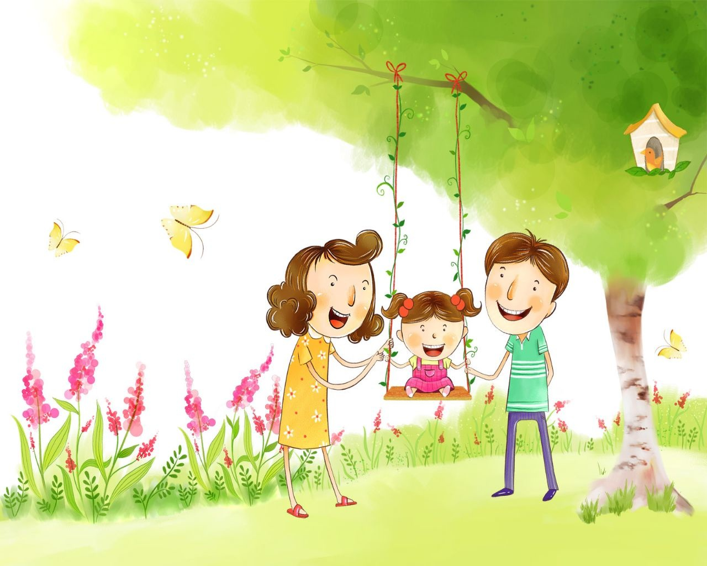
How is your mother?
She is fine, thanks.
How is your father?
He is fine, thanks.
How is your sister?
She is fine, thanks.
How is your brother?
He is fine, thanks.

Slide 5
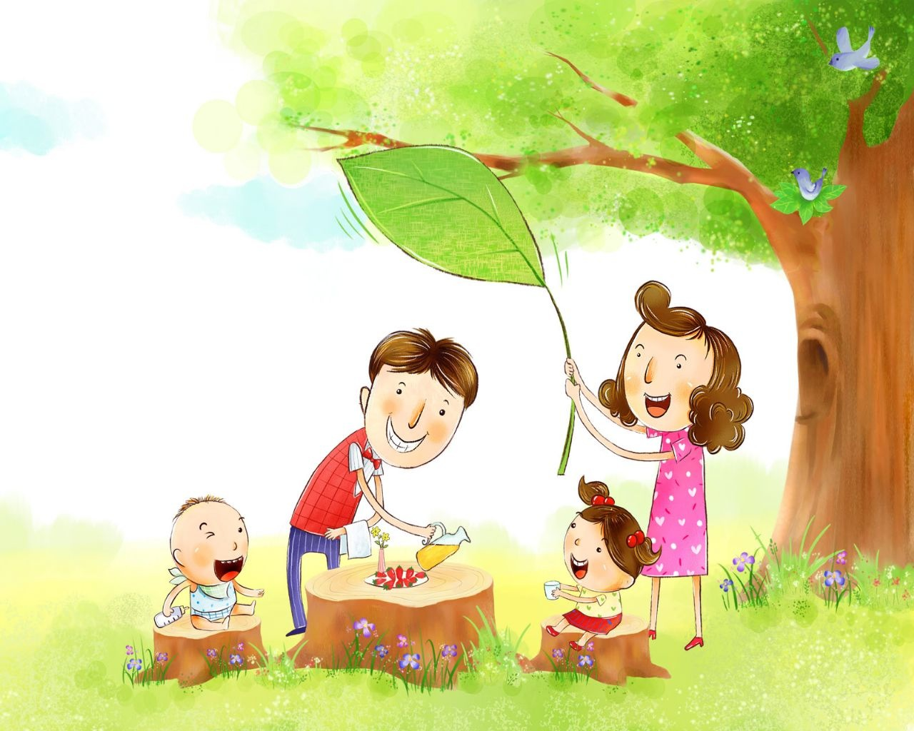
This is a family Let’s count them and see, How many there are, And who they can be.
This is the mother Who loves everyone. And this is the father Who is lots of fun.
This is my sister She helps and she plays, And this is the baby He’s growing each day.

Slide 6
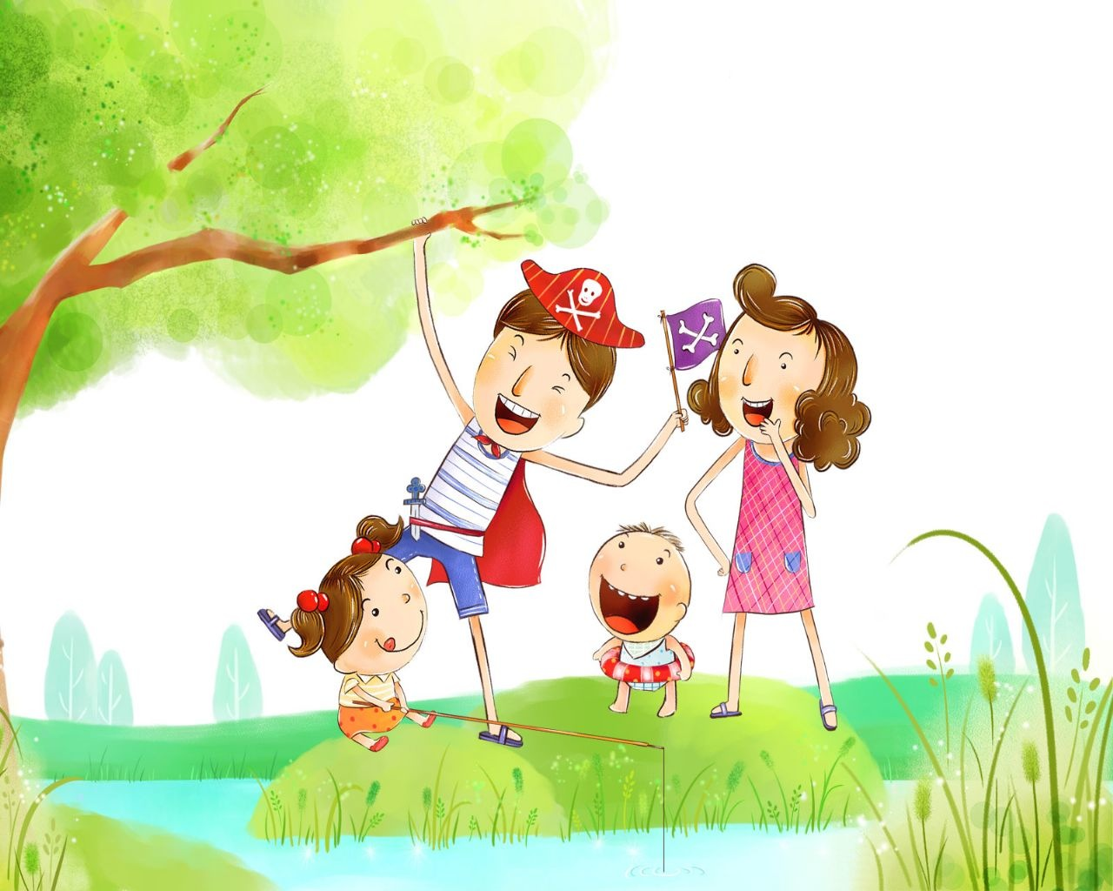
Mother is busy
From morning till night
To keep her family
Happy and bright.

Slide 7
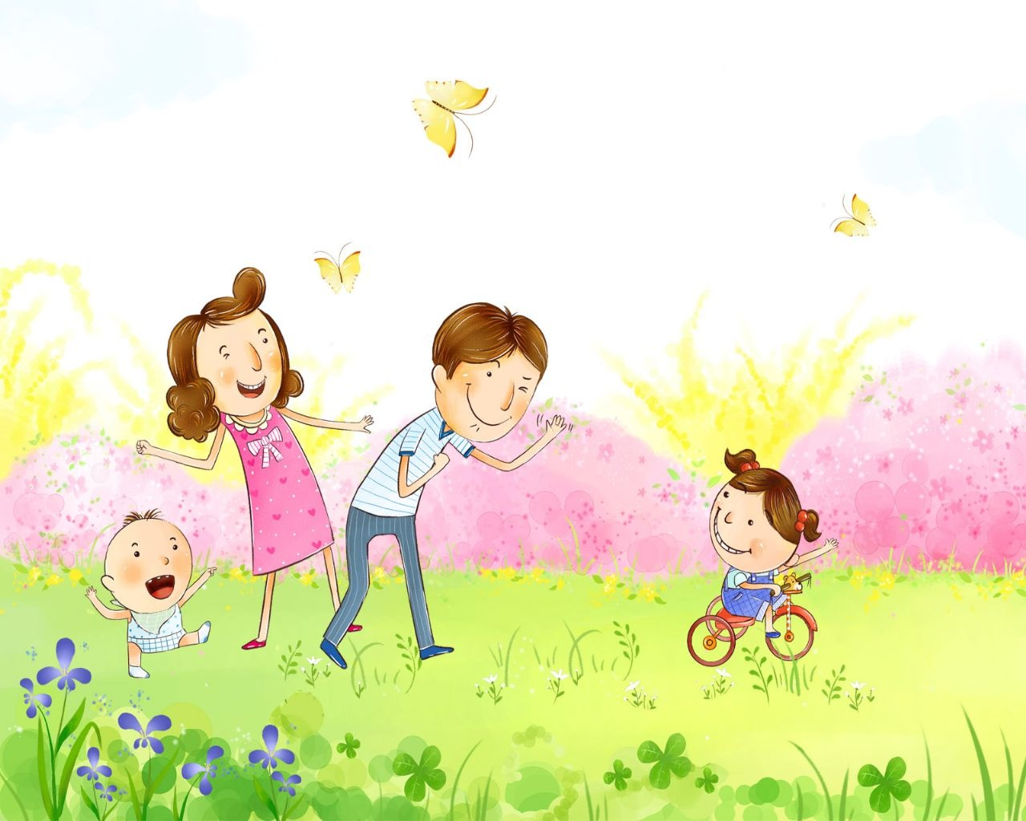
This is the Father, kind and true. This is the mother who cares for you. This is the brother so big and tall. This is the sister who plays with her ball.

Slide 8
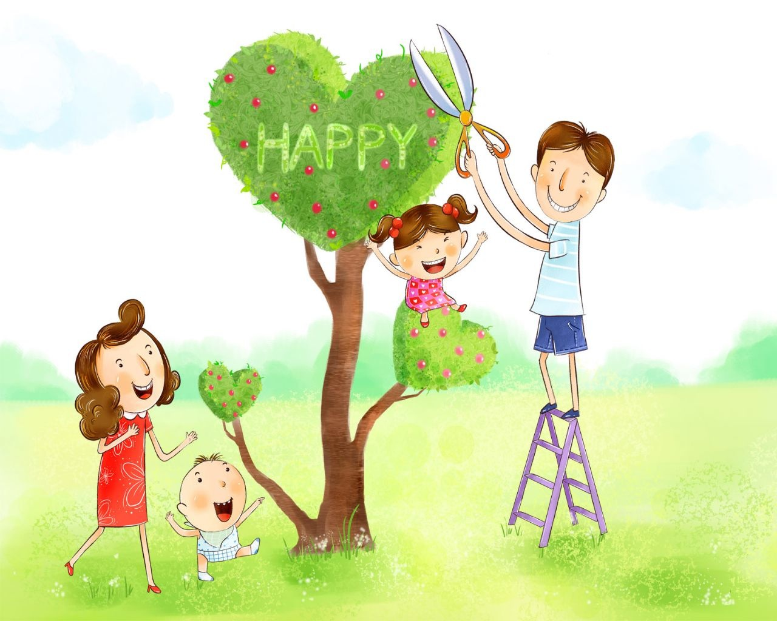
My sisters and brothers
All go to school.
We help one another.
It is a good rule.
We help our mother,
When she washes or cooks.
Together with Father
We like to read books.

Slide 9
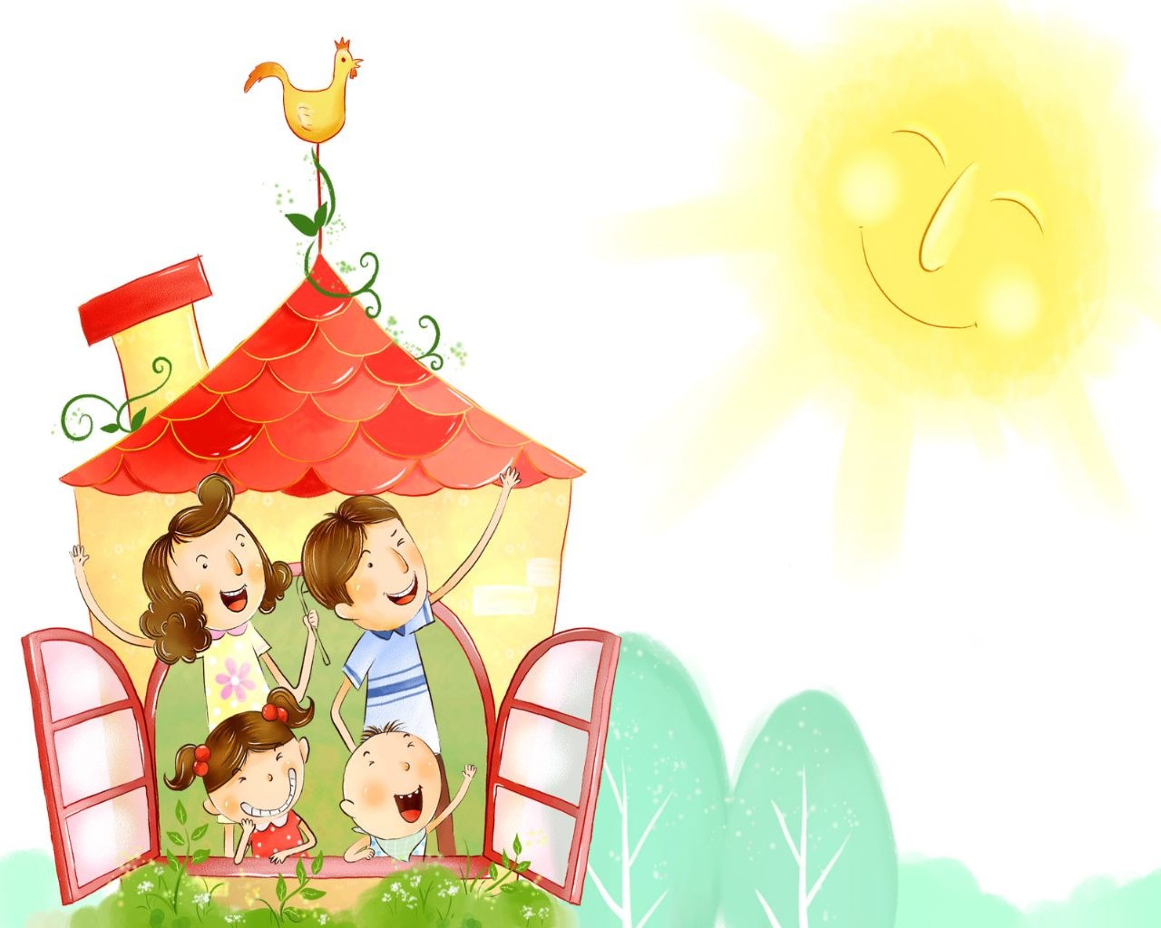
My sister is two.
My brother is three.
Sam is four
and then there is me.
Six in our family
Two hamsters and a cat.
Here is a picture
of us in our flat.

Slide 10
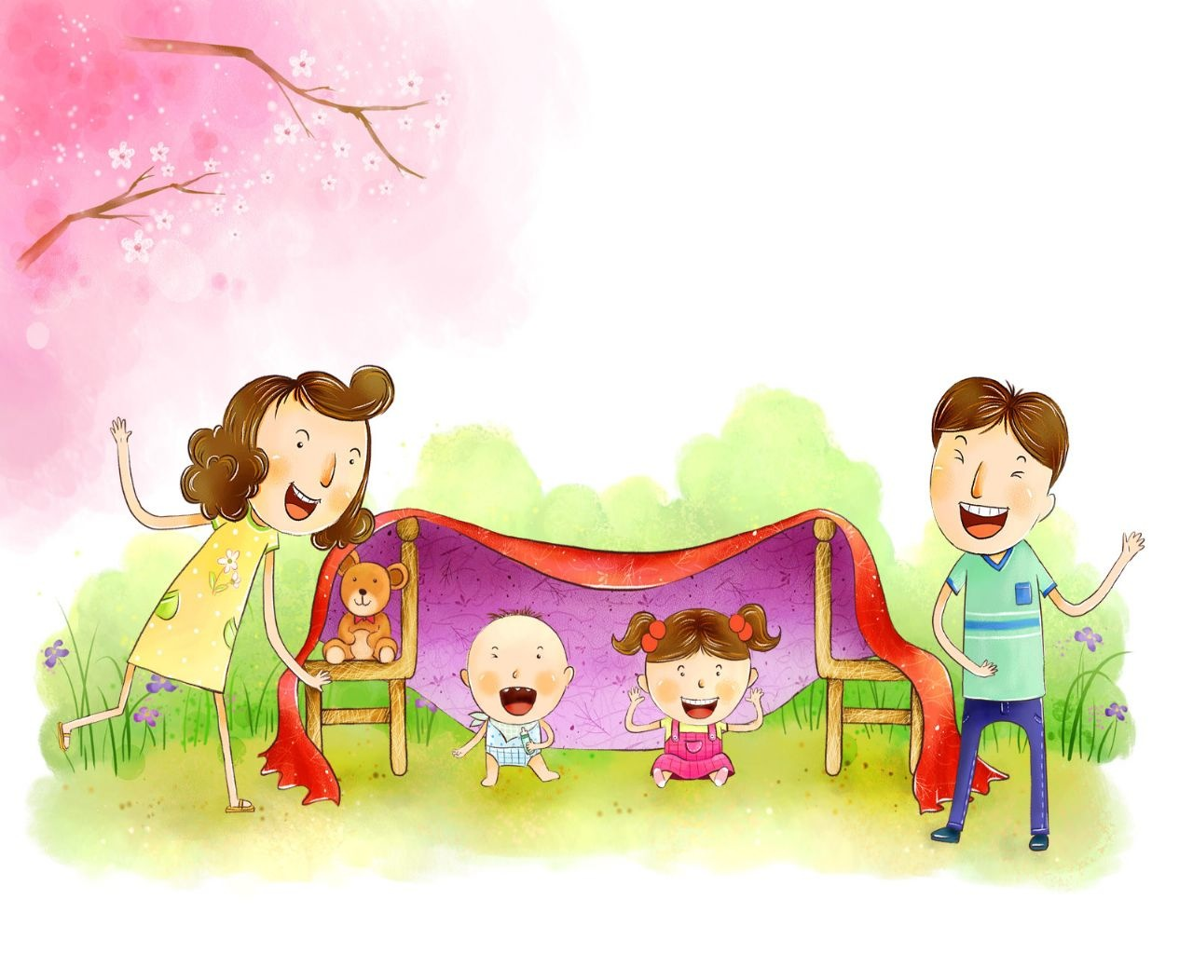
Mother is the dearest of all friends I know.
She helps me with a lot of things,
That’s why I love her so.
Father is the kindest of all friends I know.
He likes to take me out with him,
That’s why I love him so.

Slide 11
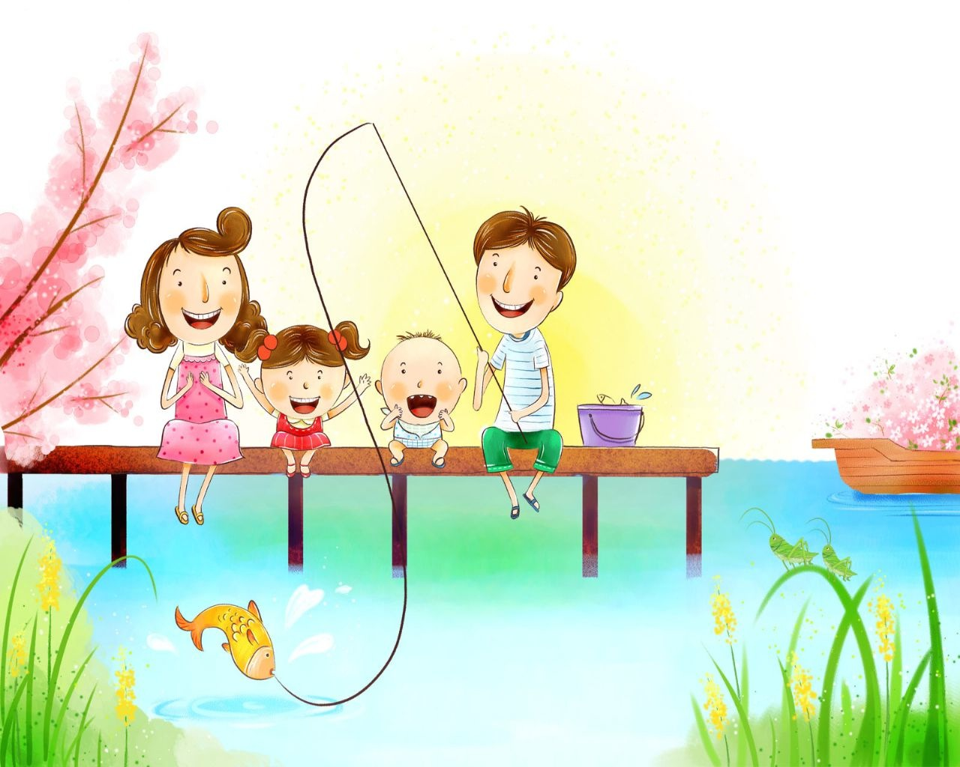
Some families are large. Some families are small. But I love my family Best of all!

Slide 12
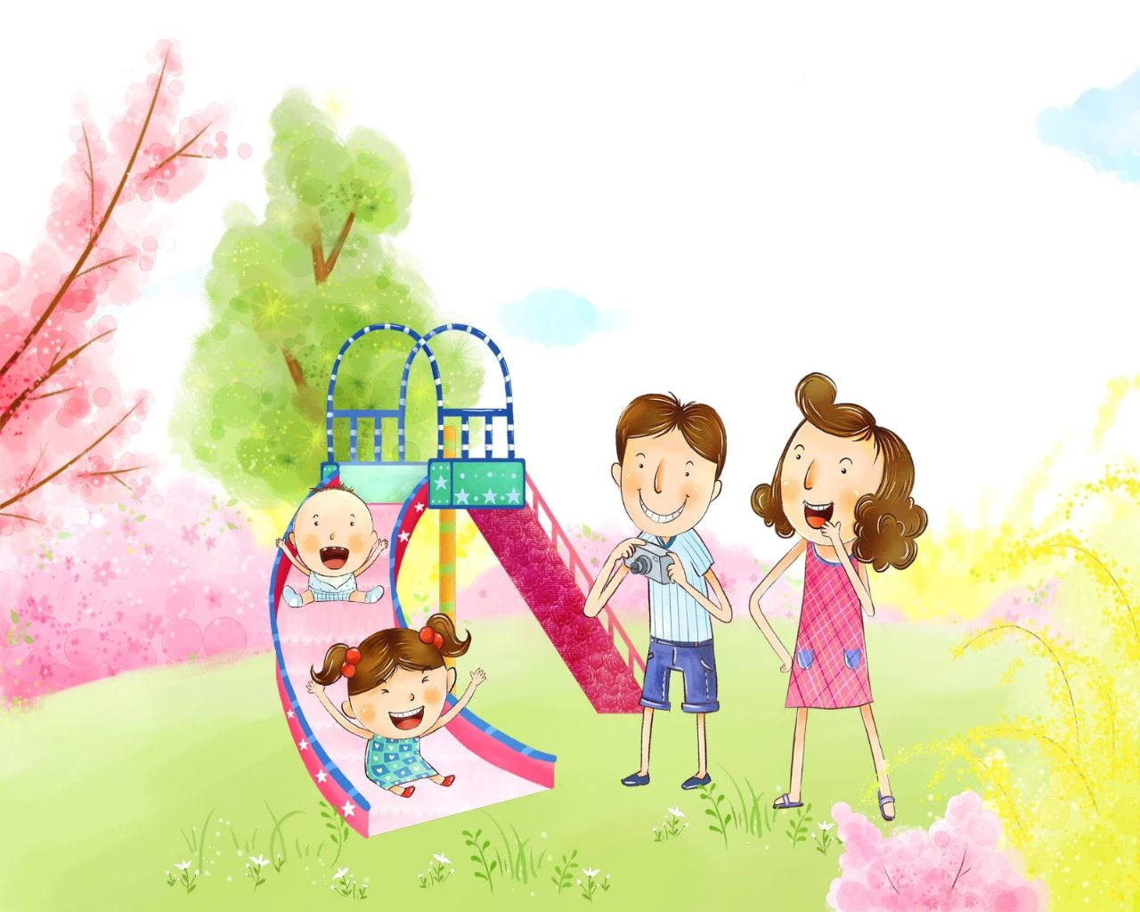
We laugh and cry, We work and play, We help each other every day.
The world’s a lovely Place to be Because we are a family.

Slide 13
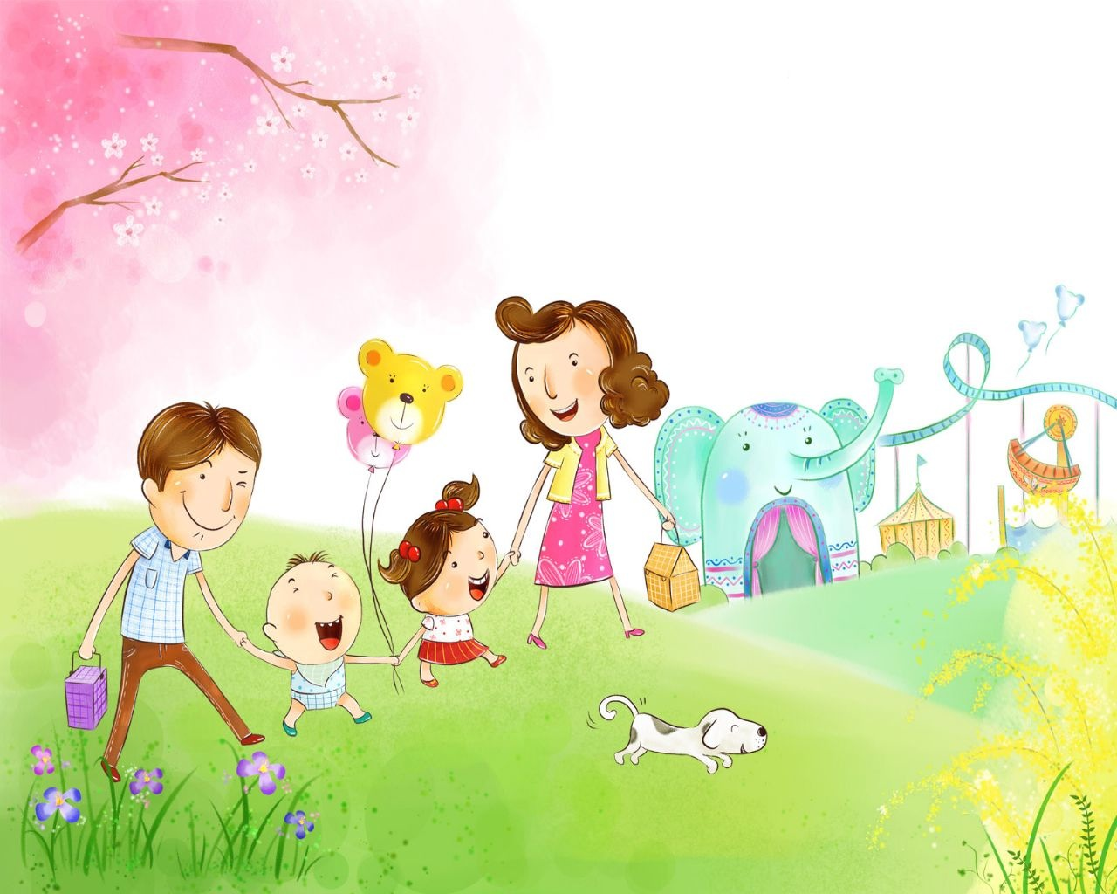
I have a brother.
His name is Paul.
He is nine.
And he’s very tall.
I fell over
and hurt my knee.
My brother Paul
looked after me.

Slide 14
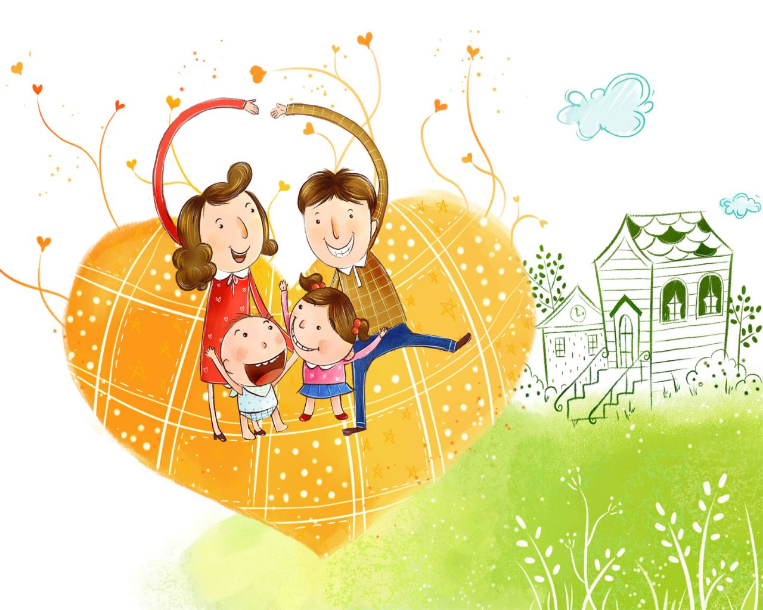
RESOURCES
http://wallpapermood.com/album/show/1003/912/2008/Cartoon/XingFuJiaTing/1280x1024/11
http://www.gigglepoetry.com/poemcategories.aspx
http://ok-english.ru/stihi-na-angliyskom-dlya-detey-semya/
http://pesochnizza.ru/english/poems-for-mom-on-8-march
http://kenglish.ru/korotkie-stixi-na-temu-semya-family/
http://www.youtube.com/watch?v=stanezmA-hk
http://www.familypoet.com/for-children/

